Slide 1

Student Attendance Management
Using Bit Manipulation in C++
Presented by
Gowmika AP24110010527
Hamsavalli AP24110010516
Keerthana AP24110010298
Madhulika AP24110010302
Jasmitha AP24110010299
Likhitha AP24110010308

Slide 2

Introduction and Overview
This section introduces the attendance management program, emphasizing the importance of efficient student attendance tracking using bit manipulation for compact storage and quick access to attendance data.

Slide 3


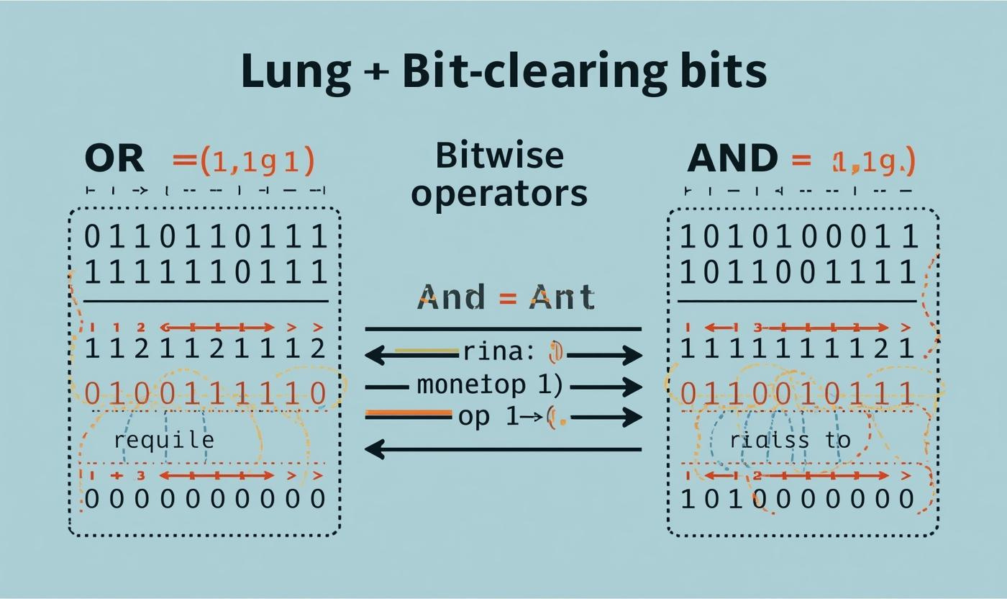
Marking Attendance
This section details how attendance is recorded using bit manipulation, explaining how each student's presence is represented by bits and demonstrating the logic for marking attendance efficiently.

Slide 4
Menu-driven Interaction
This section covers the user interface of the program, allowing users to efficiently manage attendance through a simple interactive menu for various operations.

Slide 5
Program Operations
01
02
03
Count Present Students
Count Absent Students
Check Attendance
This function counts all students present.
This calculates total minus present students.
Verify attendance for a specific roll number.

Slide 6
Program Operations
04
05
06
Show bits
used
Replace attendence of s roll number
Exit
Stops the program and close attendence system safely.
Displays how many bits are used for attendence strorage.
Modify attendence of a specific roll number

Slide 7
SOURCE CODE :
int main() {
int totalStudents, roll, choice;
char status;
printf("Enter number of students (max 32): ");
scanf("%d", &totalStudents);
if (totalStudents > 32 || totalStudents < 1) {
printf("Invalid number of students!\n");
return 0;
}
printf("\n------ Mark Attendance ------\n");
for (roll = 1; roll <= totalStudents; roll++) {
printf("Roll %d → Enter P/p for Present or A/a for Absent: ", roll);
scanf(" %c", &status);
markAttendance(roll, status);
}
while (1) {
printf("\n MENU \n");
printf("1. Count Present Students\n");
printf("2. Count Absent Students\n");
printf("3. Check Attendance of a Roll Number\n");
printf("4. Show Bits Used\n");
printf("5. Replace Attendance for a Roll No\n");
printf("6. Exit\n");
printf("Enter choice: ");
scanf("%d", &choice);
#include <stdio.h>
unsigned int attendance = 0;
void markAttendance(int roll, char status) {
if (status == 'P' || status == 'p') {
attendance |= (1 << roll);
}
else if (status == 'A' || status == 'a') {
attendance &= ~(1 << roll);
}
else {
printf("Invalid entry! Use P/p or A/a.\n");
}
}
int countPresent() {
int count = 0;
unsigned int temp = attendance;
while (temp) {
temp &= (temp - 1);
count++;
}
return count;
}

Slide 8
switch (choice) {
case 1:
printf("Total Present: %d\n", countPresent());
break;
case 2:
printf("Total Absent: %d\n", totalStudents - countPresent());
break;
case 3:
printf("Enter Roll Number: ");
scanf("%d", &roll);
if (roll >= 1 && roll <= totalStudents) {
if (attendance & (1 << roll))
printf("Roll %d is PRESENT.\n", roll);
else
printf("Roll %d is ABSENT.\n", roll);
} else {
printf("Invalid roll number!\n");
}
break;
case 4:
printf("Total Bits Used for Attendance = %d bits\n", totalStudents);
break;
case 5:
printf("Enter Roll Number to Replace: ");
scanf("%d", &roll);
if (roll >= 1 && roll <= totalStudents) {
printf("Enter new status (P/p or A/a): ");
scanf(" %c", &status);
markAttendance(roll, status);
printf("Attendance updated for Roll %d.\n", roll);
}
else {
printf("Invalid roll number!\n");
}
break;
case 6:
printf("Exiting program...\n");
return 0;
default:
printf("Invalid option!\n");
}
}
return 0;
}

Slide 9
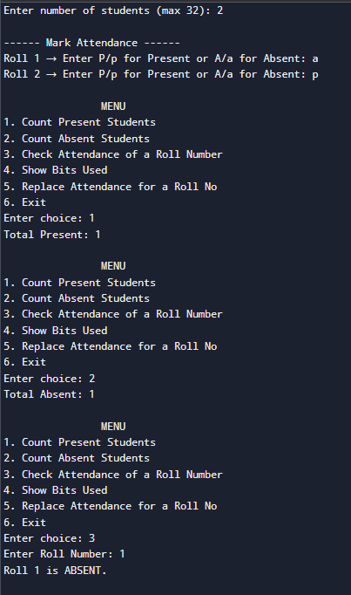
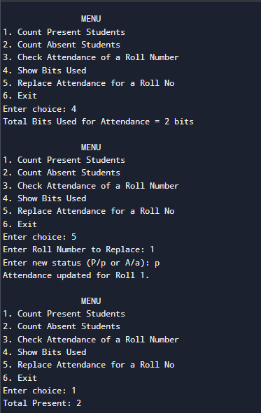
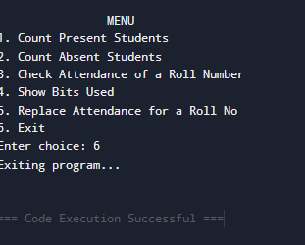
SAMPLE OUTPUT :

Slide 10
Conclusion and Key Takeaways
This section summarizes the key benefits of using bit manipulation in attendance management, emphasizing memory efficiency and speed, while encouraging further exploration of C++ bitwise operations.

Slide 11
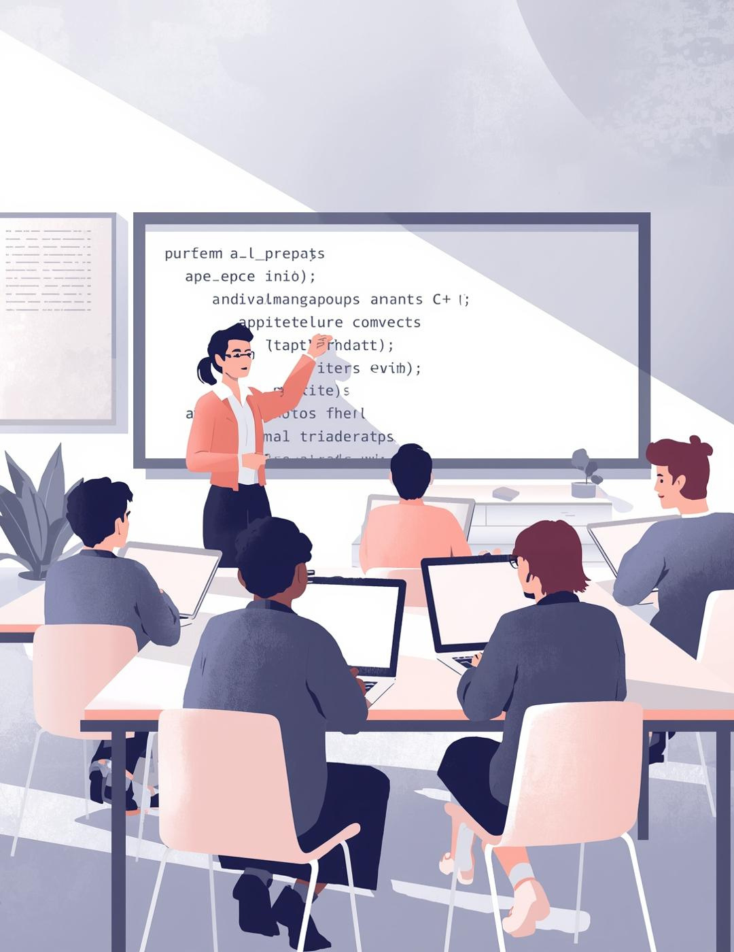
Thank you!

